Slide 1
Karl Marx
Dr. Syed Mehdi Abbas Zaidi
Associate Professor
Department of Sociology
Shia PG College, Lucknow

Slide 2
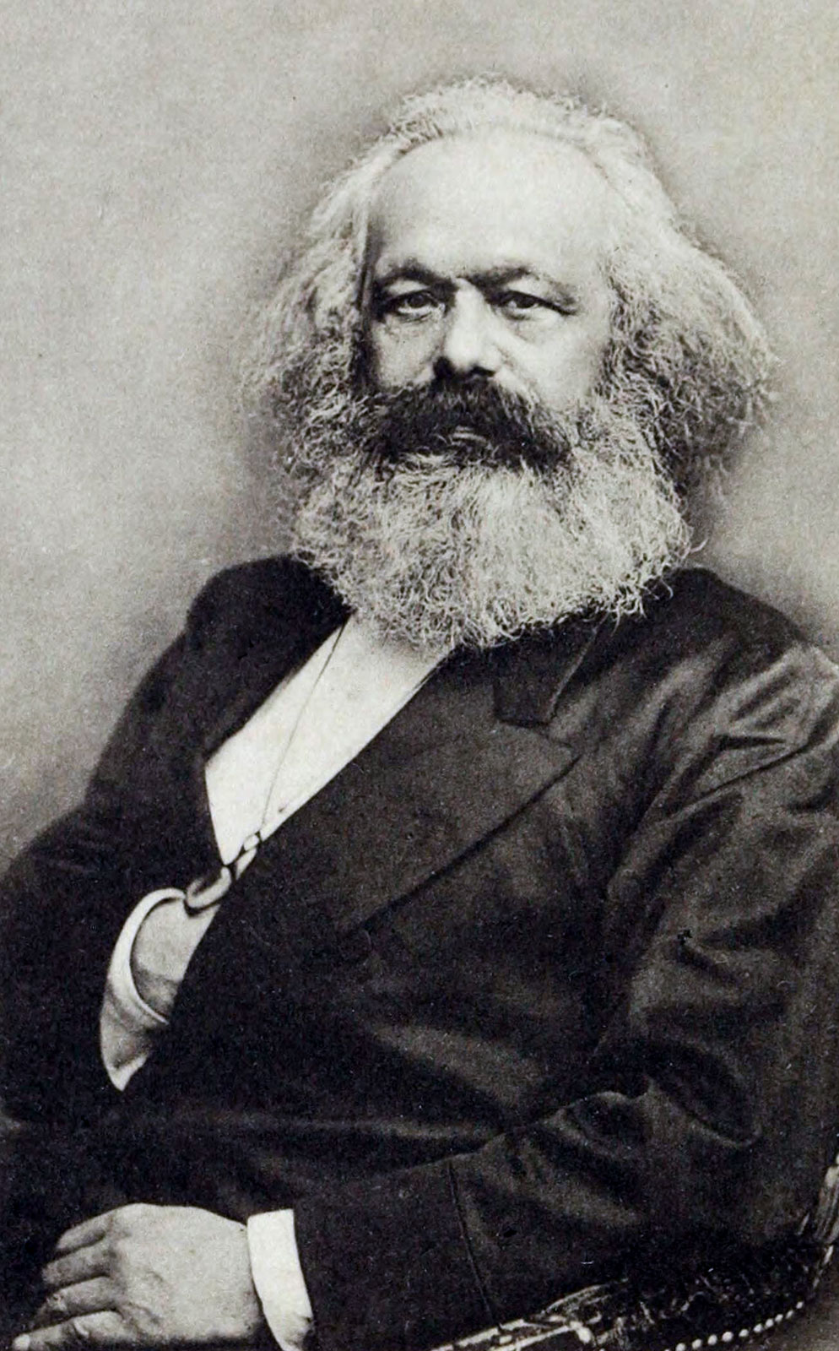
Karl Marx (5 May 1818 - 14 March 1883)
Father of modern socialism, communism, and conflict theory.
Marxism is a Western intellectual tradition spanning 150 years, consisting of 3 components:
A political doctrine
A philosophy (or anti-philosophy) of History
And an analysis of the functioning of the economy

Slide 3
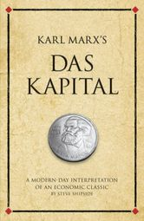
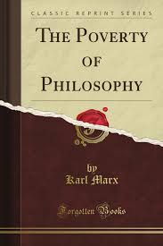
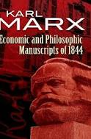
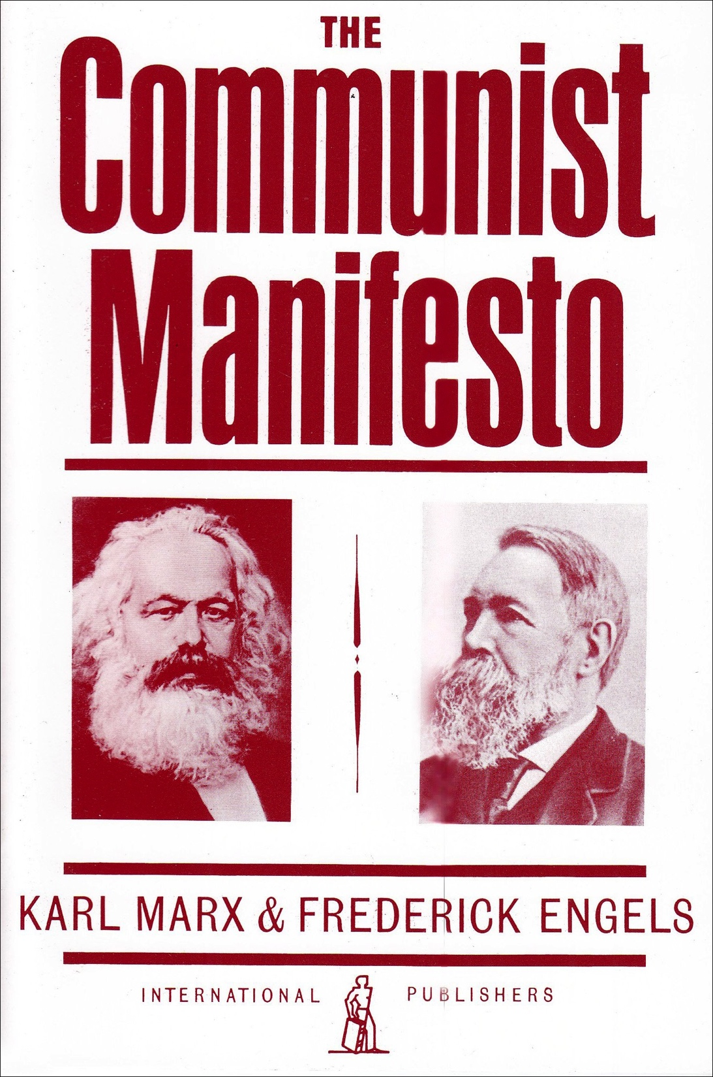
Marx’s Major Works

Slide 4
Dialectical Materialism
In simplified form, Dialectical Materialism states that ideas and thoughts of human changes in a dialectical process due to the movement and existence of the matter.
Dialectical Materialism is not only a philosophy but also a complete way of thinking to explain the reality.

Slide 5
Hegel’s Dialectics & Feuerbach’s Materialism
Marx & Engels embraced Hegel’s notion of dialectical change over rigid metaphysics, but they rejected his idealist interpretation of history.
They adopted Feuerbach’s materialism, but rejected his passive, determinist view of history.

Slide 6
Dialectics: Unity & Struggle of Opposites
Materialist dialectics is a way of conceptualizing change in everything: in nature, in history & in thought.
Change is the inevitable process of struggle, contradiction & tension between opposite, yet unified mutually transforming forces.
Contradiction transforms each side, both negating & producing into a new conflicting unity.
Something old is transformed into something new.
Quantitative & Qualitative change are dialectically related to each other.

Slide 7
Dialectical Process
In general terms a thesis is a starting point, an antithesis is a reaction to it and a synthesis is the outcome.
The movement from one stage to another in society could be explained by using thesis, antithesis and synthesis.
The outcome, in the long term would be a new form of relations within a classless society, namely communism. This would be the synthesis.

Slide 8
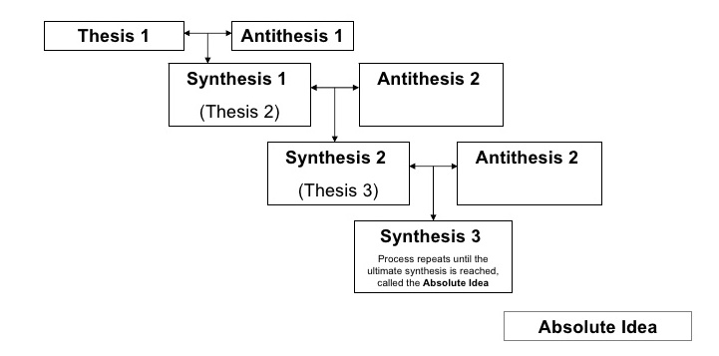

Slide 9
The Law of Dialectics
The Law of Unity of Conflict of Opposes.
The Law of Passage of Quantitative Changes into Qualitative Changes.
The Law of Negation of Negation.

Slide 10
Historical Materialism
Marx identifies production as essential for human existence.
Production is a social activity.
Co-operation is of importance
Divisions of Labor : Different People have different jobs.
Production has to be organized or ‘managed’.
Different forms of production: “modes” of production=different type of society.

Slide 11
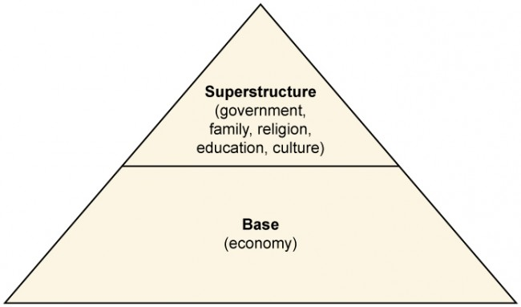
Continuum
How stuff is produced is what matters most. This is the ‘base’ of society. Marx calls the rules, customs, laws, and beliefs determining how the wealth should be distributed, the superstructure.
“Economic base”: Economic relations determine social relations, and social institutional practices (i.e. superstructure).

Slide 12
Continuum
The system of class division is dependent on mode of production.
Society moves from stages to stages when the dominant class is displaced by a new emerging class.
Mode of production also determines all expressions of “civilization”: Law, Philosophy, art, Religion etc.
There is a distinction between means of production and the relations of production.

Slide 13
Means and Relations of Production
The means of production
Land
Natural resources
Technology
Relations of production
The social and technical relationships people enter into. As they acquire and use the means of production.
The comprised not only relations among individual, but between among groups of people or classes.

Slide 14
Social Superstructure
Ways of thinking ,values, ideas
Forms of social consciousness
Ideologies
Social Institutions
Religion
Family
Education
Media
Government /the state

Slide 15
Continuum
Economic base shapes the social Superstructures.
The economic base is controlled by ruling class.
Superstructure is also controlled by ruling class.
Social institutions serves ruling class interests.

Slide 16
Types of Modes of Production
Primitive Communism
Primitive society, no classes, very low divisions of labor.
All work together for common good.
Ancient(slave) mode of production
Ancient Greece and Rome
Aristocracy and slaves
Slaves do most of work

Slide 17
Continuum
Feudal mode of production(feudalism)
Medieval Europe
Feudal landlords and peasants
Peasants do all the work
Capitalist mode of Production(capitalism)
Capitalists and workers (Bourgeoisie and proletariat)
Socialism/Communism
No classes: equality

Slide 18
Forces of Production
The forces of production express the degree to which human beings control nature. The more advanced the productive forces are, greater is their control over the nature and vice versa.
According to Marx, the forces of production includes means of production and labour power.
The forces of production, according to Marx, include means of production and labour power.

Slide 19
Continuum
In every social order there is a continuous change in the material forces of production.
The development of the forces of production is primary because it results from a factor, which is, in a sense, exogenous.
Productive forces have an intrinsic tendency to develop, as human beings’ knowledge and mastery over nature increase.

Slide 20
Relation between Base and Superstructure
In Marxist theory, society consists of two parts: the base (or substructure) and superstructure.
The base comprises the forces and relations of production (e.g. employer–employee work conditions, the technical division of labour, and property relations) into which people enter to produce the necessities and amenities of life.
The superstructure determines society's other relationships and ideas to comprise its superstructure, including its culture, institutions, political power structures, roles, rituals, and state.

Slide 21
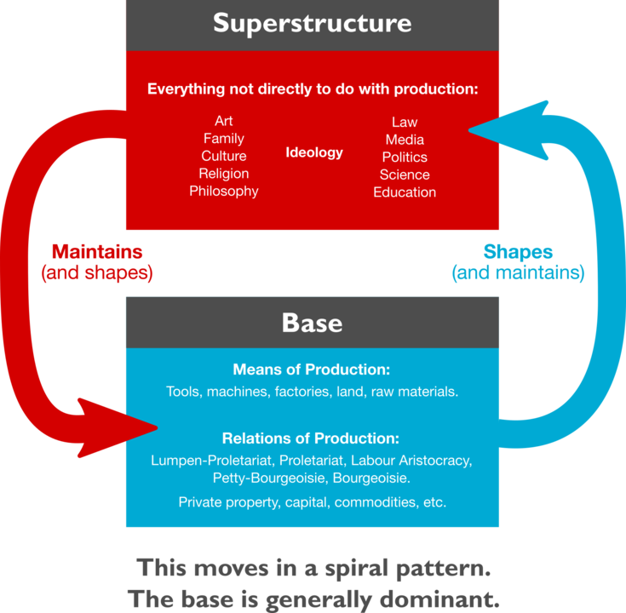
Continuum
While the relation of the two parts is not strictly unidirectional, as the superstructure often affects the base, the influence of the base is predominant.
Marx and Engels warned against such economic determinism.

Slide 22
The Social Class
According to Marx, “Class is the manifestation of economic differentiation.”
A class is defined by the ownership of property. Such ownership vests a person with the power to exclude others from the property and to use it for personal purposes. In relation to property there are three great classes of society:
The bourgeoisie (who own the means of production such as machinery and factory buildings, and whose source of income is profit), landowners (whose income is rent), and
The proletariat (who own their labor and sell it for a wage).

Slide 23
Continuum
Class thus is determined by property, not by income or status.
These are determined by distribution and consumption, which itself ultimately reflects the production and power relations of classes.

Slide 24
Class Consciousness
The self-understanding of members of a social class. This modern sociological concept has its origins in, and is closely associated with, Marxist theory.
Karl Marx distinguished between a ‘class in itself’ and a ‘class for itself’. A “class in itself” is simply a ‘social group whose members share the same relationship to the means of production’ .Karl Marx argued that a social group only fully becomes a class when it becomes a “class for itself.”

Slide 25
Continuum
At this stage, its members have ‘class consciousness’ and ‘class solidarity.’ Class consciousness means that ‘false class consciousness’ has been replaced by a full awareness of the true situation, by a realization of the nature of exploitation.

Slide 26
Class Struggle
According to Marx, “the history of all hitherto existing society is the history of class struggle.”
“Freeman and, slave, patricians and plebian, lord and serf, guild master and journey man, in a word, oppressor and the oppressed stood in constant opposition to one another, carried on uninterrupted now hidden and now open fight, a fight that each time ended in a revolutionary reconstitution of society at large, or in common ruin of the contending classes.”

Slide 27
Continuum
The perpetual tension, conflict or the antagonism between the owning and the non-owning class is called Class struggle.
Not only the classes but also the class struggle is economically conditioned.
Economic relationship decides, defines and determines all other forms of relationships; i.e. social, political and legal. This is what is called the concept of economic determinism by Marx.

Slide 28
Surplus Value
Karl Marx held that human labour was the source of economic value.
The capitalist pays his workers less than the value their labour has added to the goods, usually only enough to maintain the worker at a subsistence level.
Of the total worth of the worker’s labour, however, this compensation, in Marxian theory, accounts for only a mere portion, equivalent to the worker’s means of subsistence.

Slide 29
Continuum
The remainder is “surplus labour,” and the value it produces is “surplus value.”
To make a profit, Marx argued, the capitalist appropriates this surplus value, thereby exploiting the labourer.
This appropriation of surplus is Called ‘Exploitation’ by Marx.

Slide 30
Continuum
The capitalist mode of production thus presupposes that the producers' labour power has become a commodity. Like all other commodities, the commodity labour power has an exchange value and a use value.
The use value of the labour power is precisely its capacity to create new value, including its potential to create more value than its own reproduction costs. Surplus-value is the difference between total new value created by the labour power, its own reproduction costs.

Slide 31
Alienation
To cause (someone) to feel isolated or estranged: an urban environment that would alienate its inhabitants (as adj. alienated)
Marx Wrote: “the alienation of the worker is expressed thus: the more he produces, the less he can consume; the more value he creates, the less value he has… Labour produces fabulous things for the rich, but misery for the poor. Machines replace labour, and jobs diminish, while other workers turn into machines…”

Slide 32
Continuum
To survive, workers must sell the one thing that makes them distinctively human: the capacity for inventive and creative work.
Workers as a social class therefore become alienated from their human nature, what makes them essentially human.
Workers become alienated from their fellow human beings

Slide 33
Religion
‘Religion is the opium of the masses’– Karl Marx.
Explanation:
Religious suffering is, at one and the same time, the expression of real suffering and a protest against real suffering. Religion is the sigh of the oppressed creature, the heart of a heartless world, and the soul of soulless conditions. It is the opium of the masses. The abolition of religion as the illusory happiness of the people is the demand for their real happiness. To call on them to give up their illusions about their condition is to call on them to give up a condition that requires illusions.

Slide 34
Continuum
“Opium of the masses” does not only mean that religion is only a justification for suffering in this life for glory in the next.
Opium was the medicine of choice in the 19th century, prior to the invention of Aspirin, Tylenol, and Ibuprofen, and it was effective.
Marx argues that religion is the best ‘cure’ available for alienation in an alienated society. The only truly effective cure would be to abolish alienation and create a society where people have some rational control over the social forces they are producing.

Slide 35
References
Abraham M. Francis, Modern Sociological theory, Oxford University Press, New Delhi, 2008.
Martindale Don, The nature and types of sociological theory, Rawat Publications, jaipur, 1990
Rao Shankar C.N, Principles of sociology with an introduction to social thought, S .Chand Publications, New Delhi, 2012
Ritzer, George- Sociological Theory
Turner J.H.- The Structure of Sociological Theory

Slide 36
Thank You

